Slide 1
Microwave Devices E511
Lecture 12
Amr Al.Awamry

Slide 2
Agenda
Filter design
Filter Prototype
Impedance and Frequency Scaling
LP,HP,BP,SP transformations

Slide 3
MW Filter design
Insertion loss method
Power loss ration
Insertion loss
Reflection coefficient is even function so it can be represented in the form :
then

Slide 4
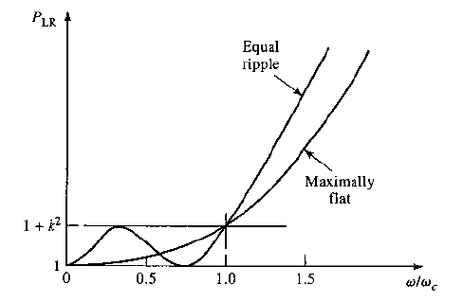
Insertion loss ..cont.
Maximally flat
Called Butterworth filter
Equal ripple
Called Chebyshev Filter

Slide 5
Filter design procedure
Passive or Active
Complete system requirements
HPF
LPF
BPF
BRF
Specify design method

Slide 6
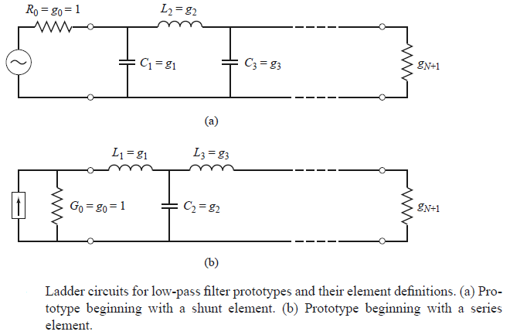
Filter Prototype

Slide 7
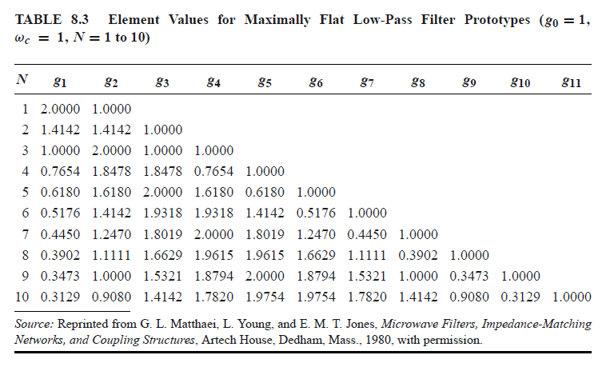
Filter Prototype …cont.

Slide 8
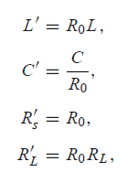
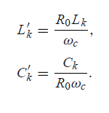
Impedance and Frequency Scaling
Now we got Low Pass filter prototype at the required cut of frequency taken into consideration characteristic impedance denormalization

Slide 9
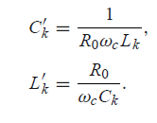
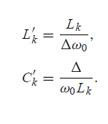
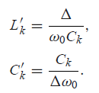
Low-pass to high-pass transformation
Bass-pass transformation
Series L
Shunt C

Slide 10
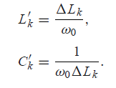
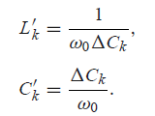
Stop-band transformation
Series L
Shunt C
Plz look at ex 8.3, ex 8.4

Slide 11
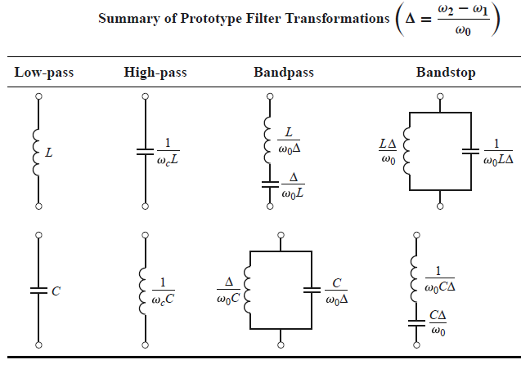
Transformation Summary

